Slide 1
Water quality and HAB monitoring
Jason E. Adolf, Ph.D., Monmouth University
Jennifer Graham, Ph.D., USGS
NJDEP 2024 HAB Training Workshop

Slide 2
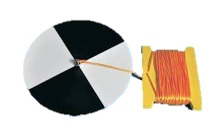
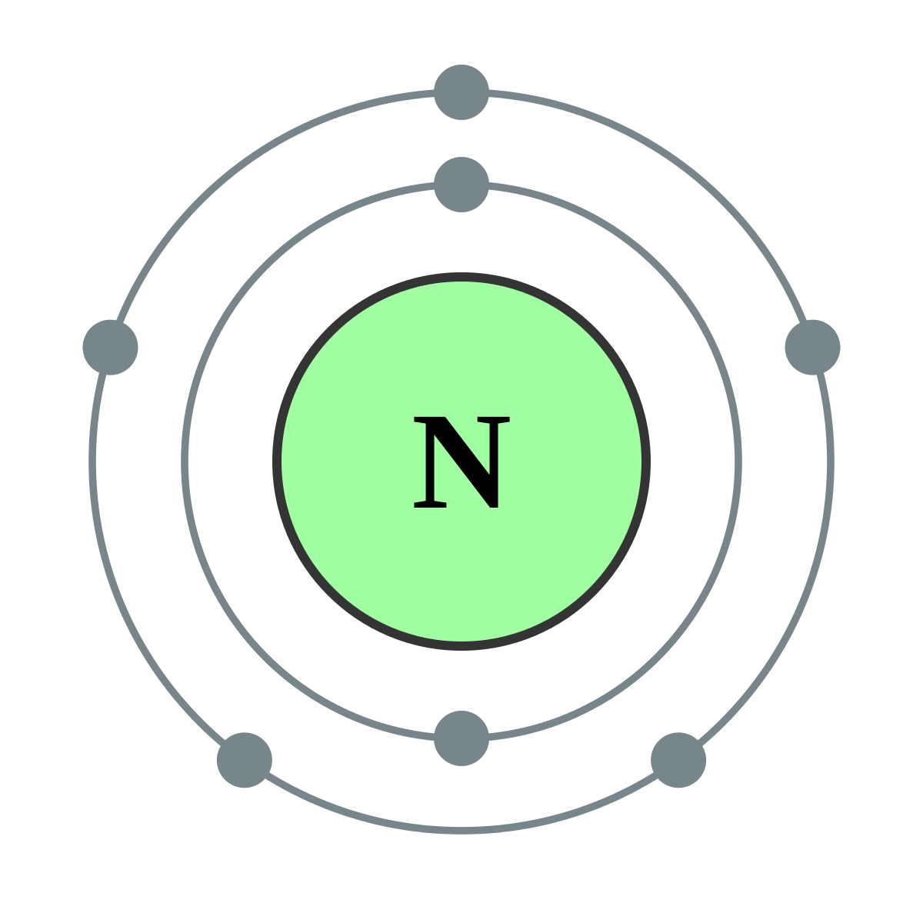
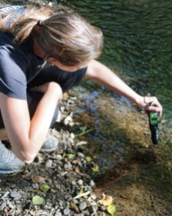
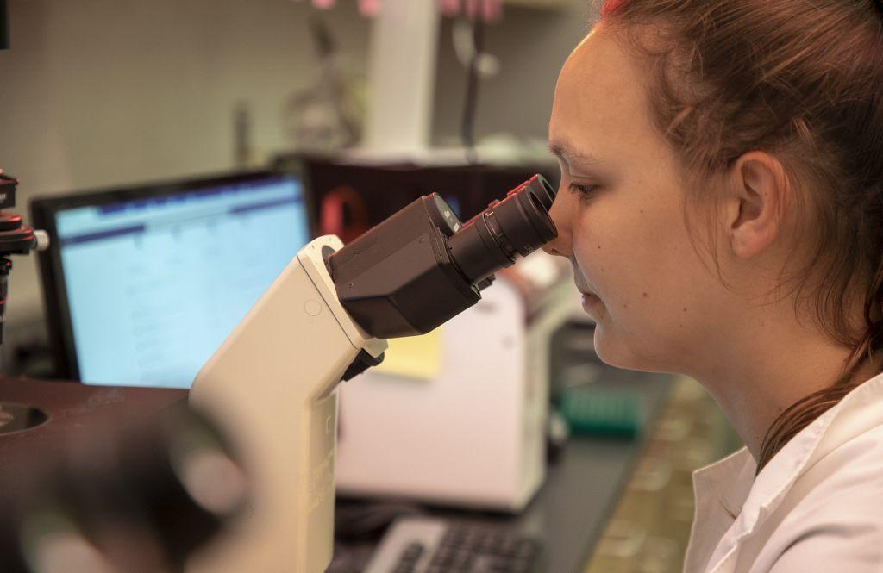
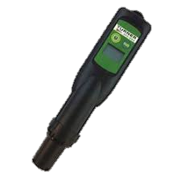
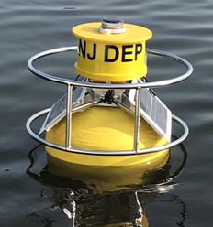
Water Quality Monitoring and Lake Conditions Chapter
Water quality vs. HAB monitoring
Developing a water quality monitoring plan for HABs
Physical
Water temp., Water clarity, Precipitation, Lake Levels
Chemical
Nutrients, Sp. Conductivity, Dissolved Oxygen, pH
Biological
Total Chl a (extract or fluorescence)
Cyanobacteria and cyanotoxins (covers several different approaches)
Phycocyanin (extract or fluorescence)
Need to establish link to cell counts noted
NJDEP resources (flights, buoys, PC fluorometer loan program)

Slide 3
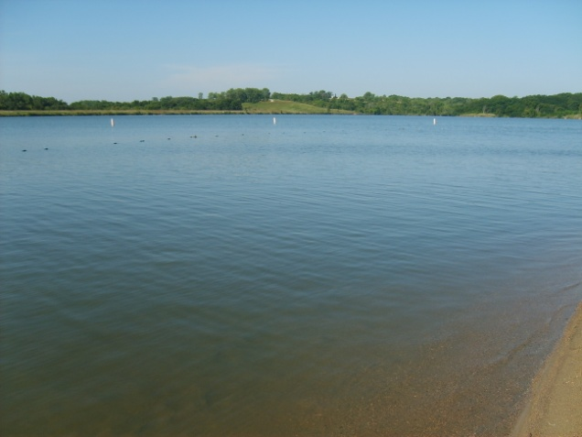
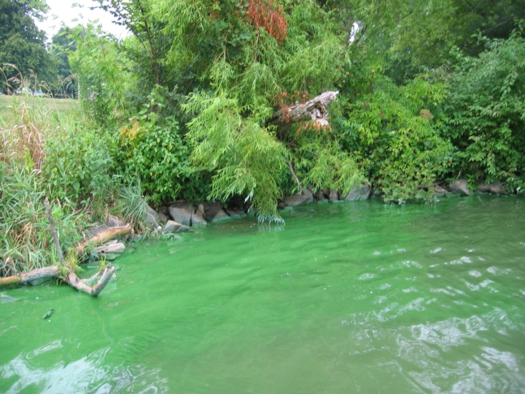
The Spatiotemporal Variability of Cyanobacteria Poses Unique Challenges to Monitoring and Assessment
Where and When to sample
Rock Creek Lake, Iowa
2006 Beach Closure Event
Beach Area
Thursday
August 3
Beach Area
Monday
July 31
Photo Credit: IA DNR
Boat Ramps
Friday
August 11
Photo Credit: IA DNR
Photo Credit: J. Graham, USGS
Notes:
This event was one of the first times Iowa closed a beach for HABs; press went to the lake as soon as the closure was announced - the entire lake looked like the August 3 photo - not a bloom to be found.

Slide 4
Concentrations of Cyanobacteria or Cyanotoxins May Vary Substantially at Different Sample Locations Within a Lake
Microcystin: 13 µg/L
Microcystin: 4 µg/L
Photo Credit: J. Graham, USGS
Samples collected about 50 m apart

Slide 5
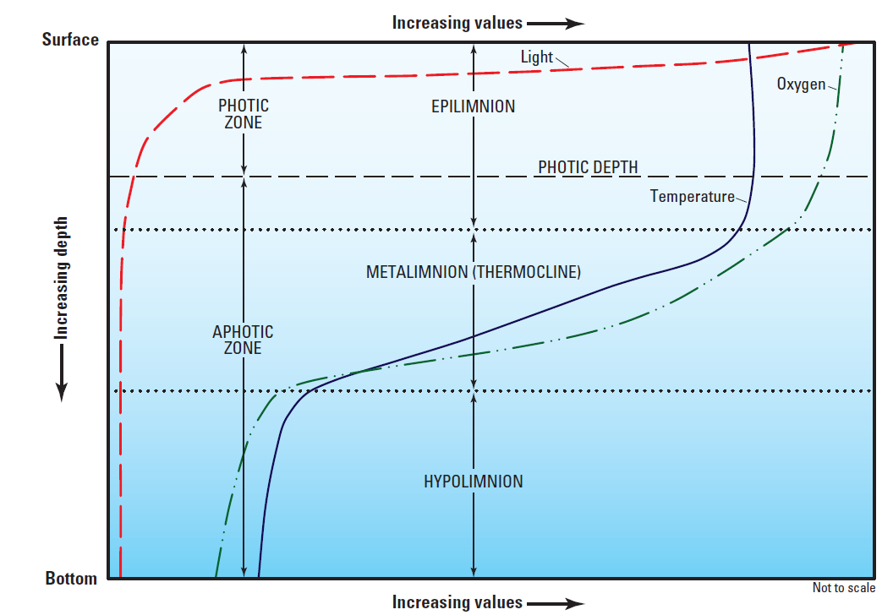
Lakes are Characterized by Vertical Gradients Caused by Light and Thermal Stratification.
Graham et al, 2008

Slide 6
Where to Sample?
Modified from Graham and others, 2008 by ITRC

Slide 7
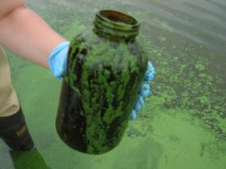
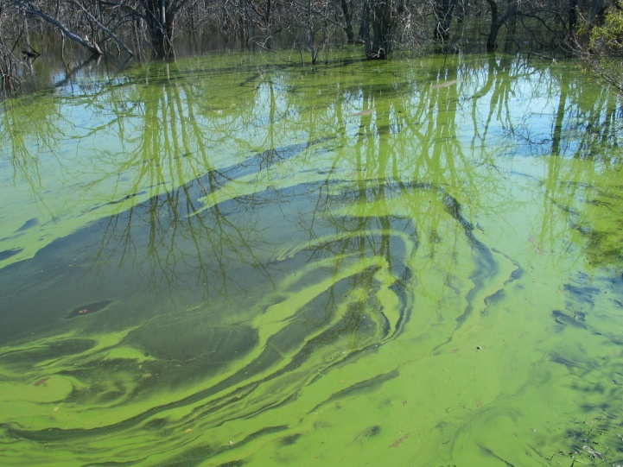
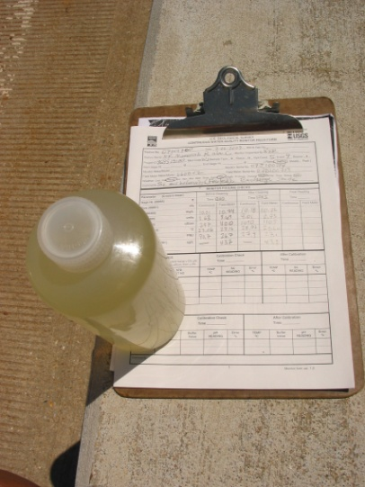
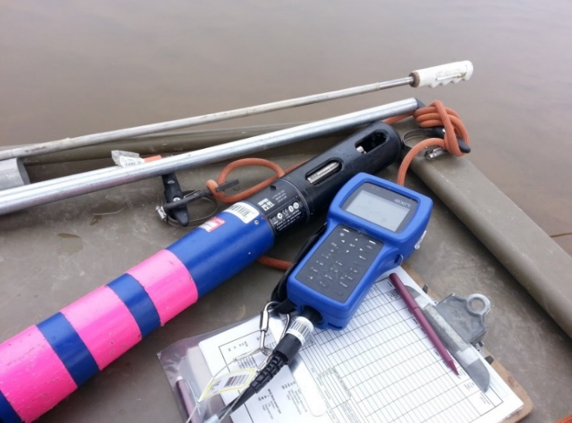
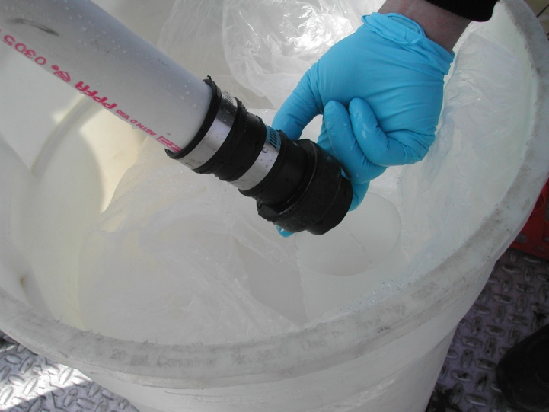
Considerations When Choosing Where and How to Sample
Specific study objectives and lake knowledge
Stratification
Spatial and/or water-column distribution of cyanobacteria
Flexibility of sampling plans
Where and how to collect samples may be decided in the field
Quality assurance and control
Spatial variability may influence field replicates
Cyanobacteria may influence split replicates
Photo Credits: J. Graham, USGS

Slide 8
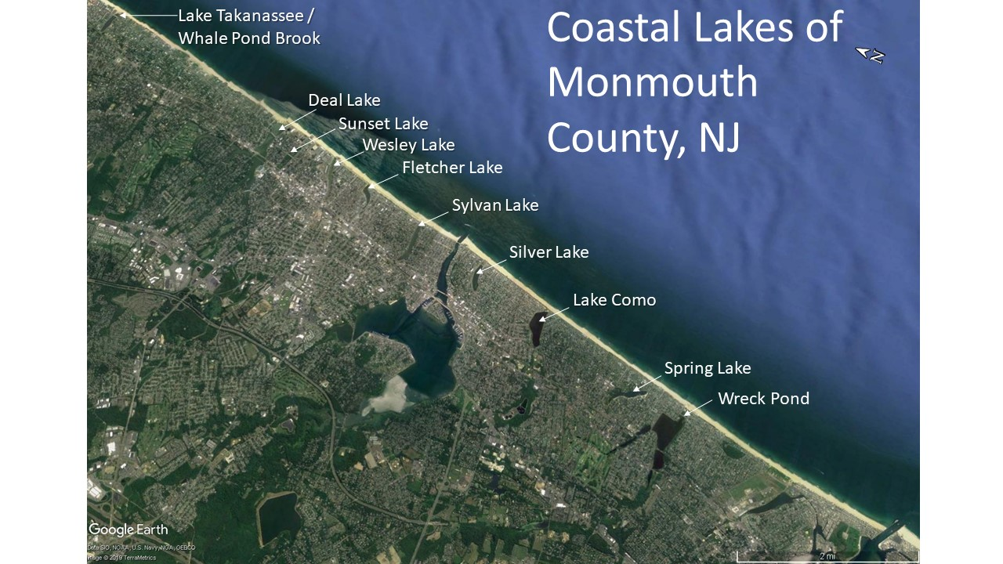
An important part of the Jersey Shore!
Historical significance and connectivity to ocean
Community use
Notes:
Threats include anthropogenic eutrophication and climate change… or poor water quality (incl. HABs, FIBs) and sediment in-filling that is reasonably thought to be driven by rainfall on the highly developed / urbanized watersheds of the lakes. And don’t forget that they have some sort of connection to the Atlantic Ocean!!

Slide 9
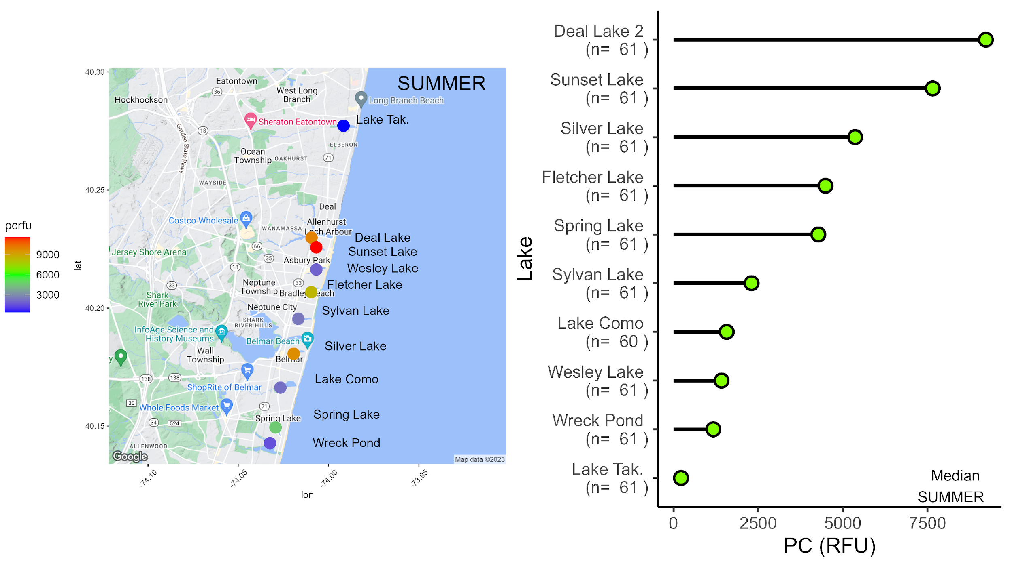
HAB biomass index
A measurement of fluorescence from phycocyanin, a characteristic pigment found in cyanobacteria including those that cause harmful algal blooms (HABs)
These lakes get the most HABs, so let’s check their WQ!
PHAB data has shown:
HABs are a currently problem affecting some lakes more than others
Summer is the main HAB season, but not exclusively
Strong relationships with cyanobacterial cell counts
This lake has never seen a HAB in 5 yrs of study!

Slide 10
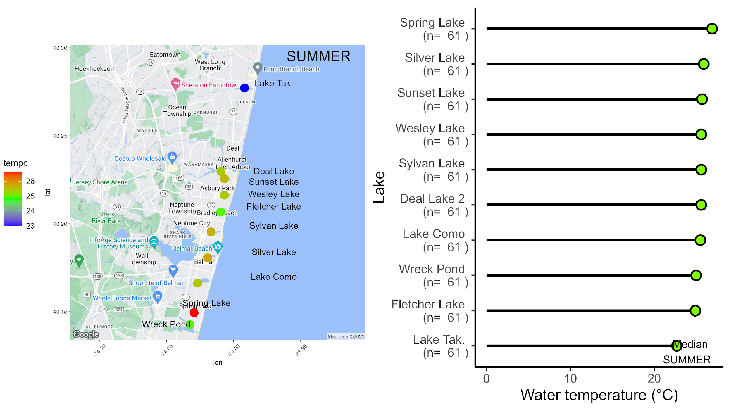
Water temperature
A key environmental variable dictating biology. Critical parameter for tracking effects of global climate change.
Currently, lakes’ summer temperatures favor HABs over other phytoplankton
PHAB data has shown:
A similar trend as seen in community data
Lake Takanassee is consistently cooler than other lakes, Spring Lake a little warmer
Evidence of Coastal Lake warming sine 1970’s and “HABs like it hot!”.

Slide 11
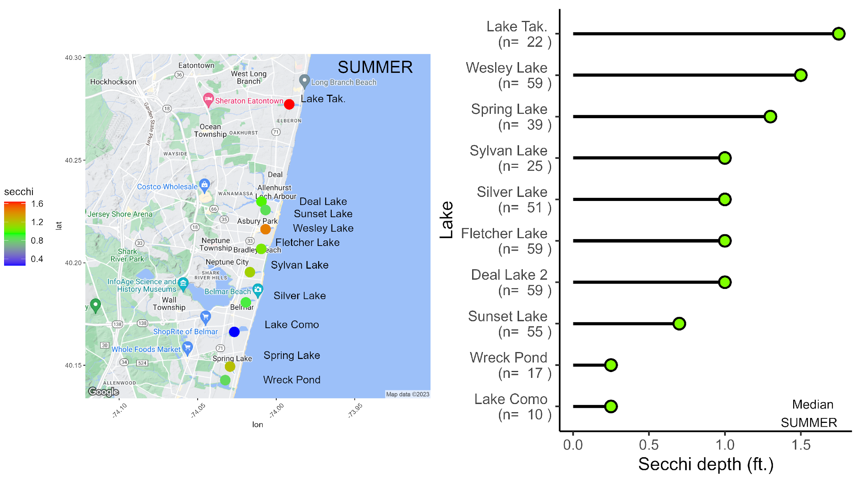
Secchi depth
A simple measurement of water clarity that has a history of being used as a broad and integrative ecological indicator across lakes globally. Global Secchi depths range ~ 0 – 100 ft. In general, higher numbers are ‘better’.
The least HABby of lakes has the clearest water
PHAB data has shown:
Similar pattern as community data
All lakes’ values are generally low

Slide 12
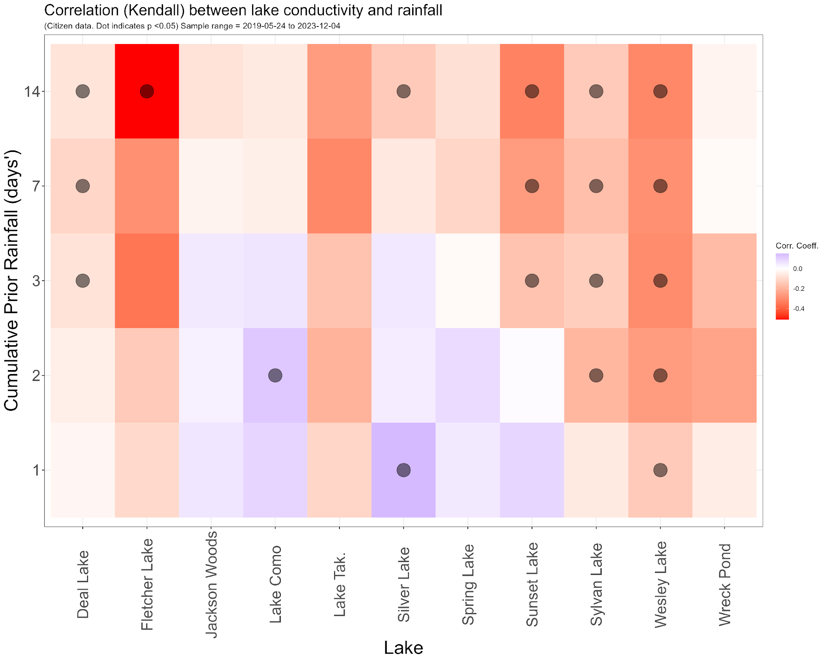
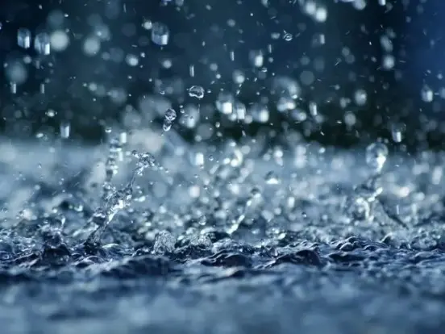
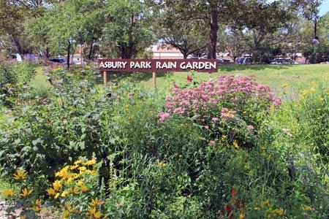
How do lake parameters relate to environmental conditions like rainfall?
Community conductivity data, indexed to local rainfall, illustrates some lakes’ tight connection to urban runoff, echoes PHAB data on nutrients ~ rainfall, and underscores the importance of watershed management
Image Zeffy Adolf

Slide 13
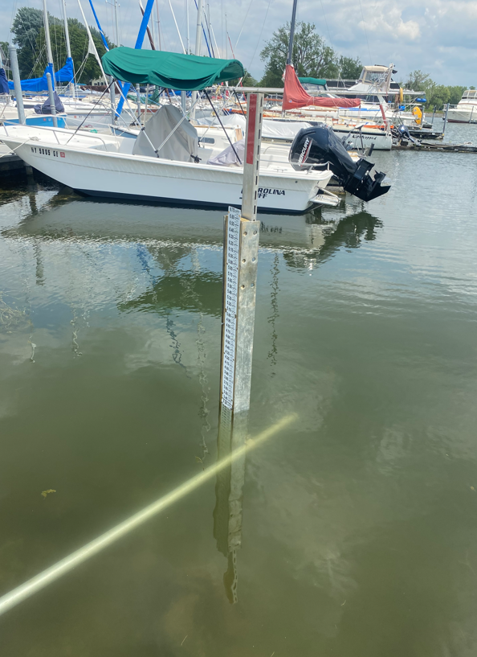
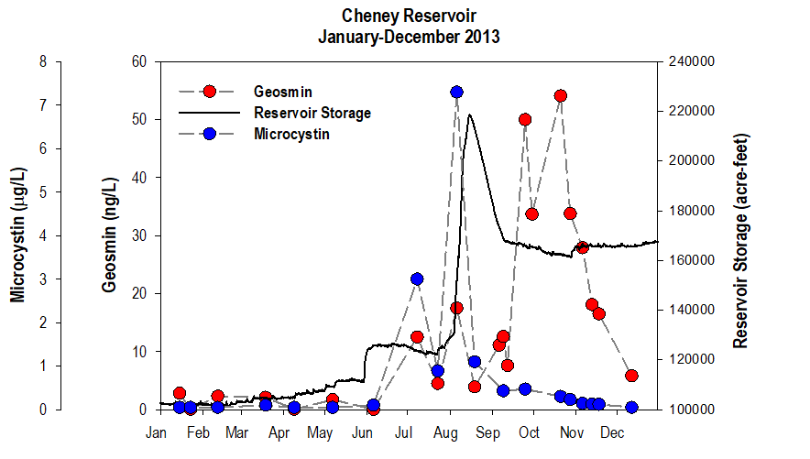
Lake elevation may be an indicator of changing conditions
Photo Credit: USGS
Photo Credit: USGS
After Otten et al., 2016 and Graham et al., 2017
Notes:
Lake elevation gages can be:
Relatively complex, and provice continuous real-time measurements (left photo and figure on right; not the same site); the figure on the right shows an ~80,000 ft change in reservoir elevation at Cheney Reservoir, Kansas following a major inflow event - the event put an end to a microcystin-producing cyanobacterial bloom…and shifted the community to a geosmin producing one; this event also changed everything we thought we knew about cyanobacterial dynamics in the reservoir up to that point - we had been studying it since 2001 - geosmin producing communities typically occurred in the winter and microcystin in the summer; following this event geosmin producing communities occurred in the winter and summer)
Relatively simple, with measurements recorded on a routine basis (staff plate, will appear with click)

Slide 14
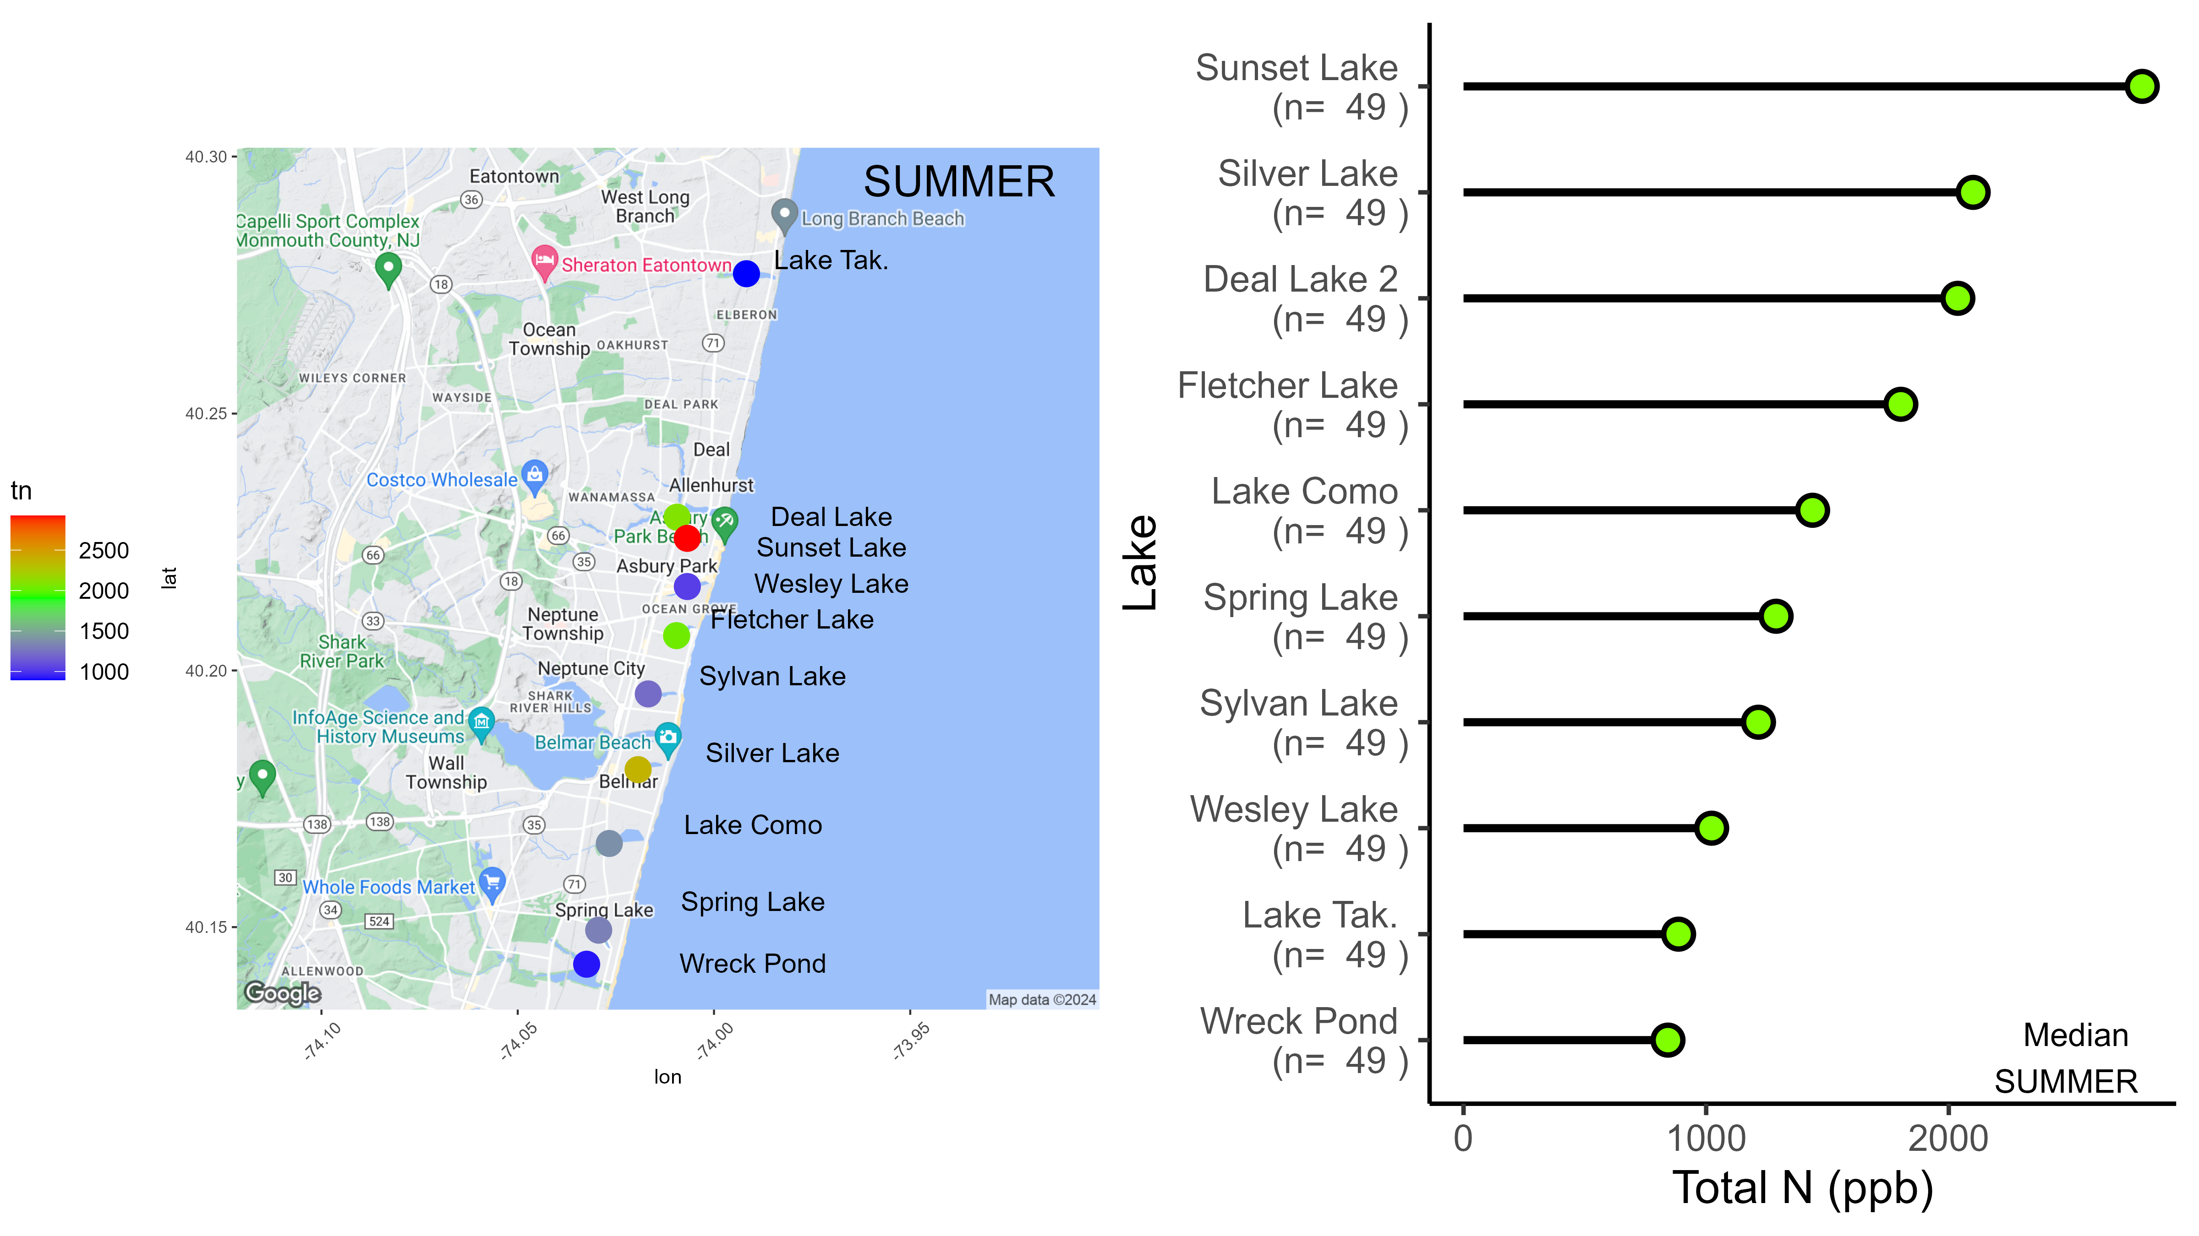
Total Nitrogen
A chemical measurement of all the N in the lake, includes dissolved and particulate fractions. TN is a common indicator of eutrophic conditions (along with Total Phosphorus).
The same lakes at the top of the HAB list are top of the TN list as well…
PHAB / NJDEP data has shown:
Coastal lakes have relatively high TN compared to other NJ lakes
HABs and TN tend to go together
In summer, lakes can be N-limited (e.g. more N, more algae)

Slide 15
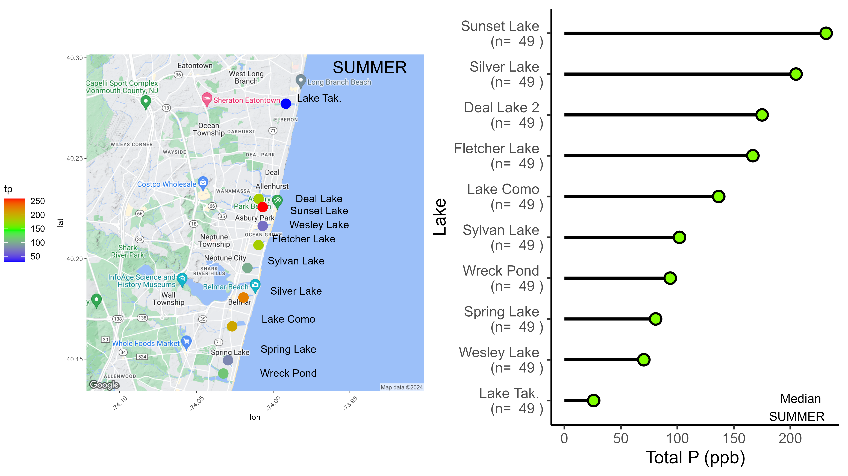
Total Phosphorus
A chemical measurement of all the P in the lake, includes dissolved and particulate fractions. TP is a common indicator of eutrophic conditions (along with Total Nitrogen).
PHAB / NJDEP data has shown:
TP tends to track TN in coastal lakes, except in Lake Takanassee where TN:TP is higher than in other lakes
In summer, lakes appear to generate excess P from sediments during HABs

Slide 16
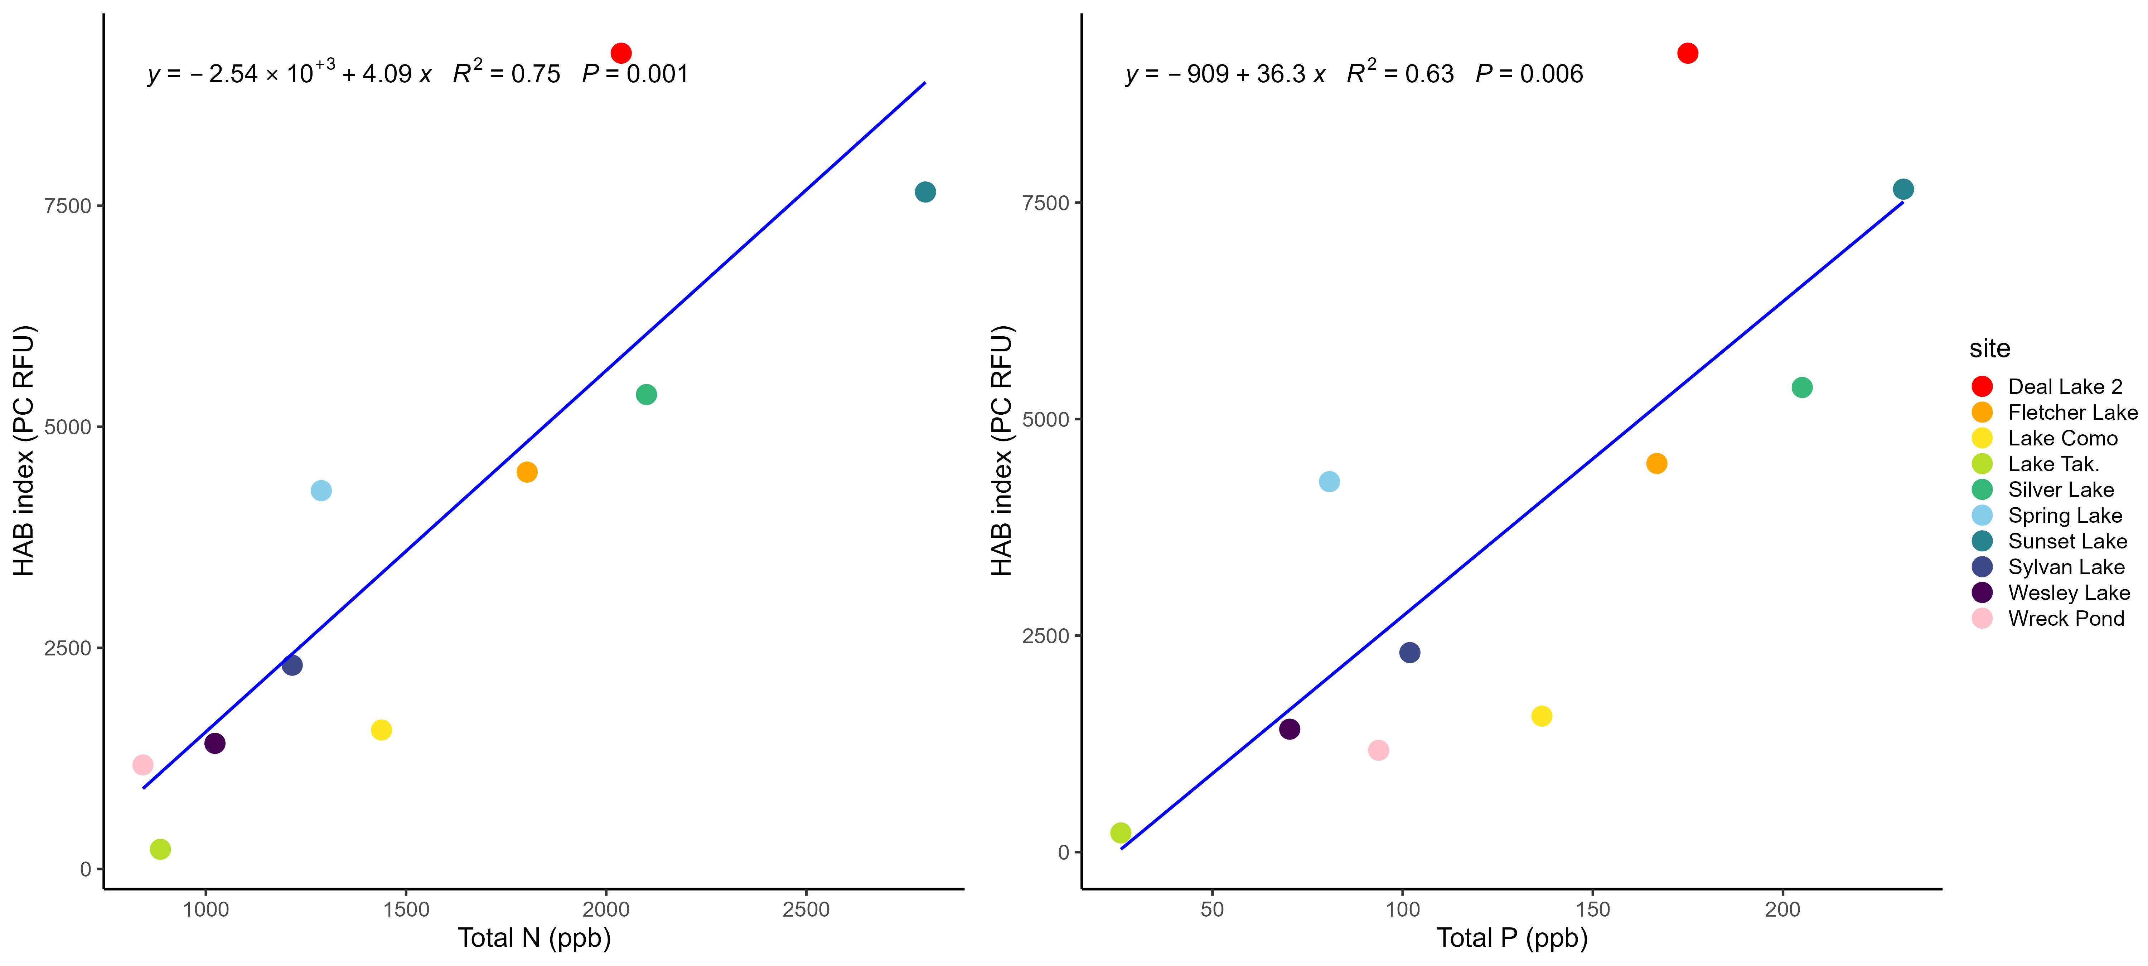
Summer TN and TP are strongly related to summer HAB index

Slide 17
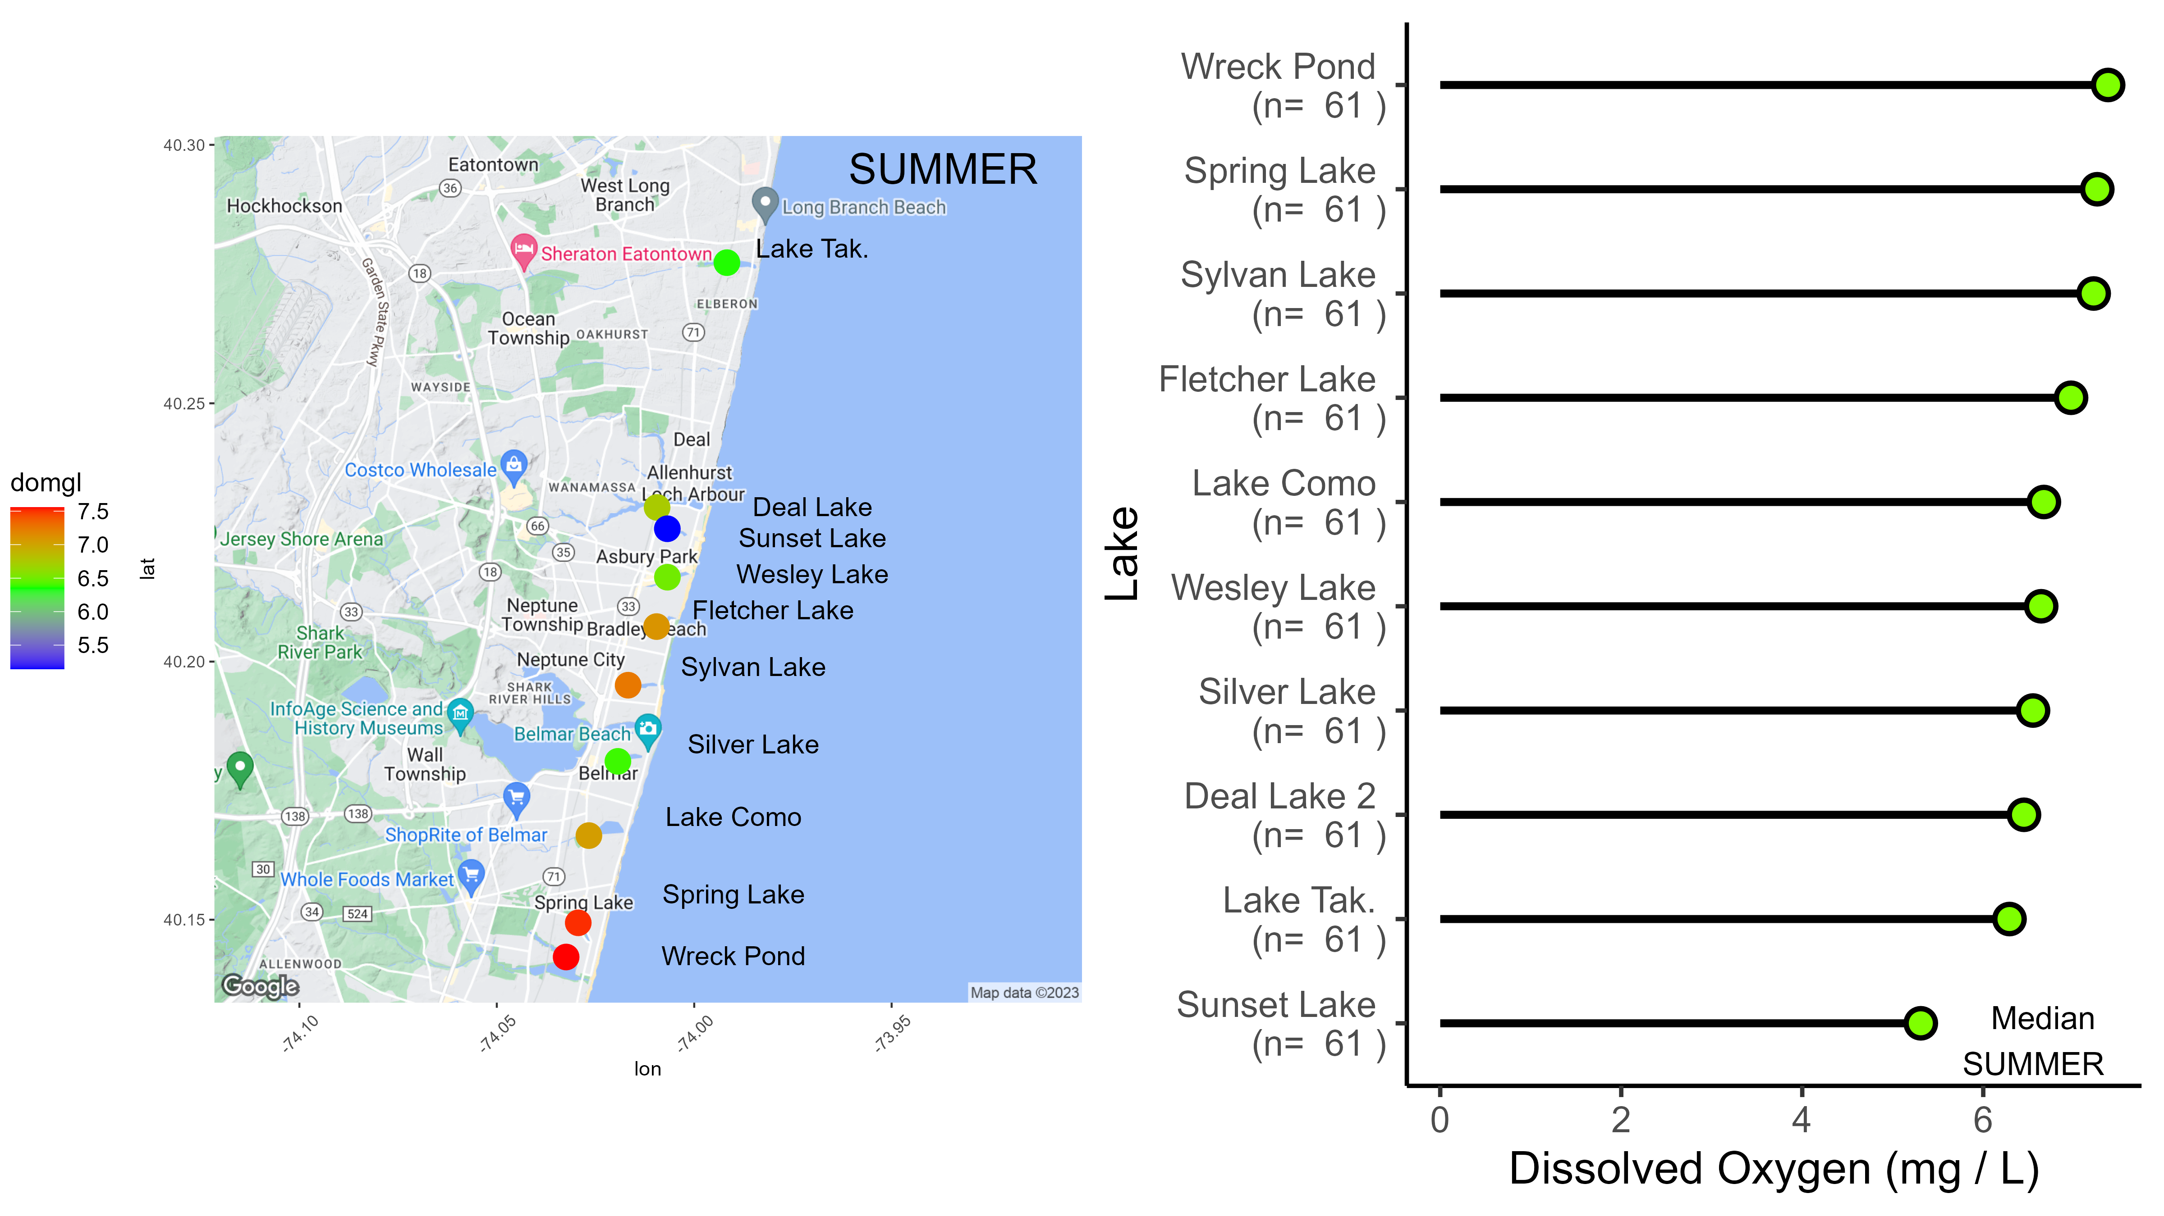
Dissolved Oxygen
A measurement of the amount of oxygen in the water. Animals start to die at < 2 mg/L. Lake chemistry changes under low D.O. conditions. Values typically show high day / night variability (e.g. lower D.O. at night).
In eutrophic lakes, high D.O. during daytime is common, but this can be deceptive!
PHAB data has shown:
Mostly OK values measured in daytime
Other low daytime D.O. events observed occasionally that signal problems

Slide 18
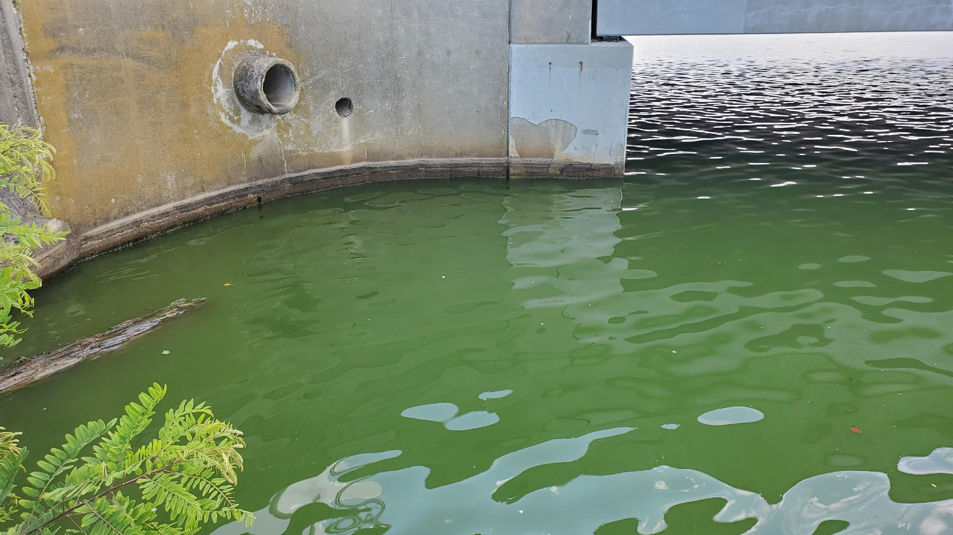
Dissolved Oxygen
A measurement of the amount of oxygen in the water. Animals start to die at < 2 mg/L. Lake chemistry changes under low D.O. conditions. Values typically show high day / night variability (e.g. lower D.O. at night).
Deal Lake D.O. may be OK in daytime, but following a HAB night time values go anoxic
15 minute D.O. values
Moving average
HAB index values
Nicholas Occhiogrosso
Monmouth Univ. ‘22
(2022)

Slide 19
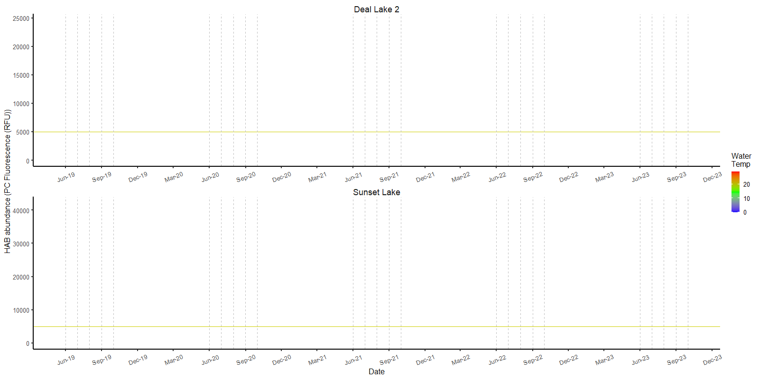
Water Quality Monitoring and Lake Conditions Chapter
WQ Monitoring is important because it…
Helps ID conditions that can lead to a HAB developing
Can reveal spatial and temporal differences in those conditions
Helps ID conditions caused by HABs
Use proactive (rather than reactive) sampling
Begin monitoring earlier and continue later – March to October

Slide 20
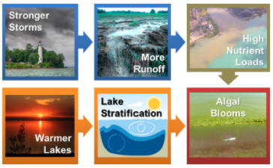
Water Quality Monitoring and Lake Conditions Chapter
Consider Climate Change in your monitoring plan
Continued, long-term monitoring is necessary to understand GCC influences on NJ HABs
https://glisa.umich.edu/wp-content/uploads/2021/02/Algal-Bloom-Contributing-Causes-1.png

Slide 21
Thank you
Resources
https://nj.gov/dep/hab/expert-team.html
My email for questions / connections
jadolf@monmouth.edu
And Thanks to Mike Danko of NJ Sea Grant Consortium for keeping us on task!

